Slide 1
Project Title :
Vehicle Automation Using Communication Protocol
Khushi Singh : 240340130025
Mayur Wagh : 240340130029
Rushi Parekh : 240340130037
Shikha Verma : 240340130040
Bipin Vishwakarma : 240340130053
Internal Guide : Tarun Bharani

Slide 2

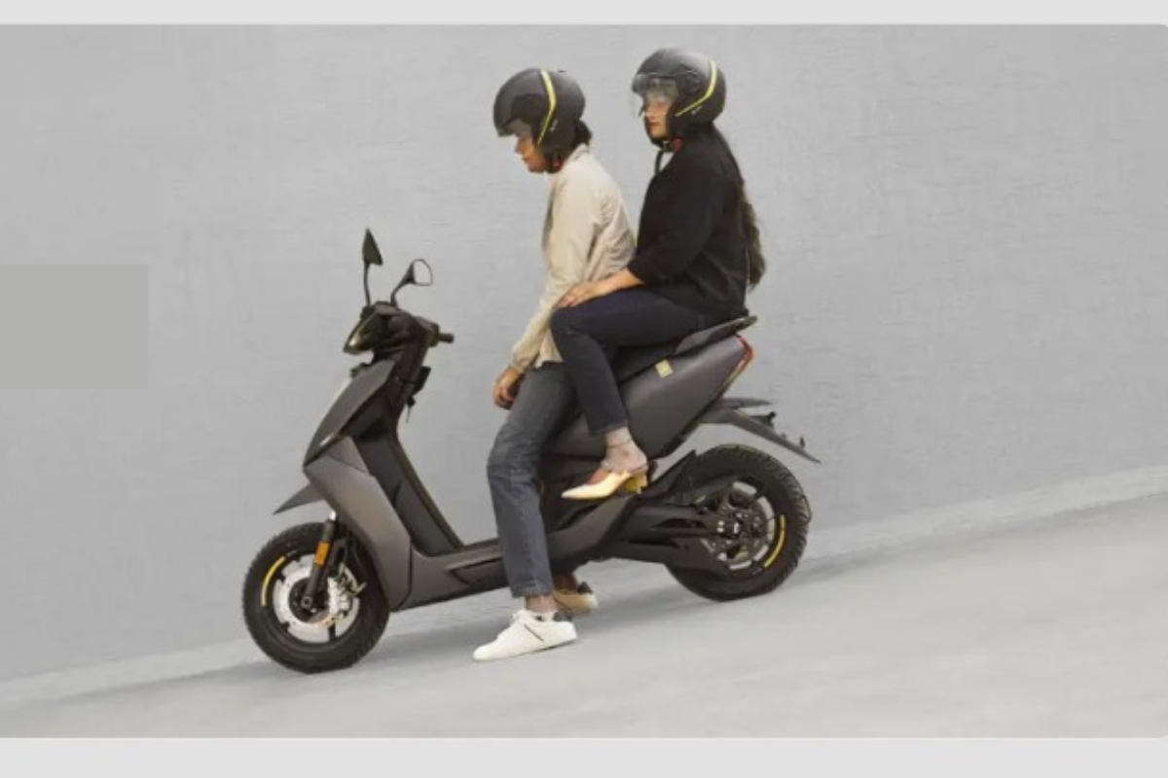
Auto Hold: Driving Convenience Reimagined
The Auto Hold feature is a revolutionary technology that enhances the driving experience by automatically maintaining brake pressure when the vehicle is stationary, providing drivers with a seamless and effortless way to navigate stop-and-go traffic.

Slide 3
Powering Auto Hold with STM32
STM32 Microcontroller
Integrated Peripherals
Reliable Performance
The STM32 microcontroller is the heart of the Auto Hold system, providing the computational power and versatility to manage the complex control algorithms and sensor inputs.
The STM32 chip integrates various communication protocols, including CAN, SPI, and I2C, enabling seamless integration with the vehicle's existing systems.
The STM32's robust architecture and real-time capabilities ensure reliable operation, even in demanding automotive environments.

Slide 4

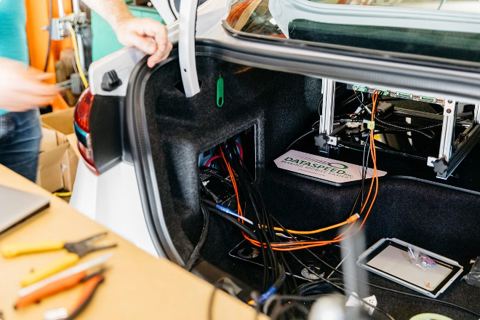
CAN Protocol: Interconnecting Auto Hold
1
CAN Messaging
The Auto Hold system utilizes the CAN protocol to communicate with the vehicle's electronic control units (ECUs), exchanging critical data and commands.
2
Fault Tolerance
The CAN bus architecture provides a robust and fault-tolerant communication network, ensuring reliable data transmission for the Auto Hold feature.
3
Real-time Performance
The low-latency CAN protocol enables the Auto Hold system to respond quickly to changes in vehicle dynamics, maintaining seamless operation.

Slide 5



SPI: Integrating Sensor Data
SPI Bus Connection
Sensor Integration
Real-time Monitoring
The STM32 microcontroller is connected to a CAN transceiver and another STM32 board via the SPI bus, enabling seamless data exchange.
The SPI interface allows the Auto Hold system to integrate sensor data, such as wheel speed and brake pressure, from various vehicle components.
The high-speed SPI communication ensures the Auto Hold system can continuously monitor and respond to changes in vehicle dynamics in real-time.

Slide 6

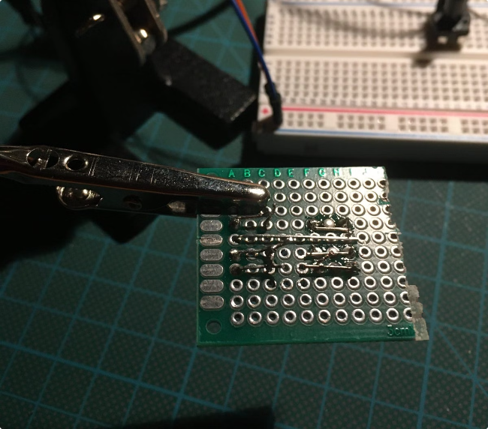
SPI: Integrating Sensor Data
Sensor Connectivity
High-Speed Data Transfer
The Auto Hold system leverages the SPI protocol to interface with various sensors, such as RPM and brake pressure sensors.
The SPI protocol's high-speed data transfer capabilities ensure that the Auto Hold system receives accurate and timely sensor data.
Flexible Configuration
The SPI protocol's versatile configuration options allow the Auto Hold system to adapt to different sensor configurations and vehicle architectures.

Slide 7


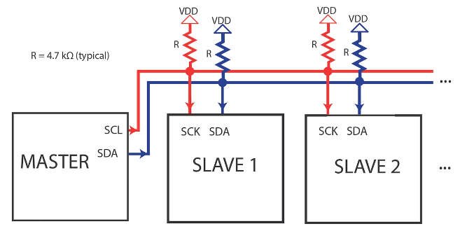


I2C: Enabling Vehicle Integration
Sensor Connectivity
The Auto Hold system utilizes the I2C protocol to communicate with the vehicle's electronic unit to show that AutoHold is enable or disable (LCD Display).
Sensor Connectivity
I2C allows the Auto Hold system to connect with a variety of sensors, providing essential data for the feature's operation.
Diagnostics
The I2C protocol facilitates the exchange of diagnostic information, enabling the Auto Hold system to monitor its own performance and report any issues.

Slide 8
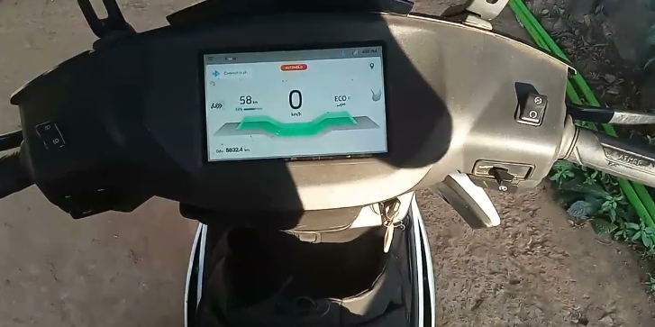
Autohold Enabled: Dashboard Display
A clear and prominent indicator light on the dashboard notifies the driver that the autohold feature is currently enabled and active.
The dashboard displays the current status of the autohold system, indicating whether the brakes are currently being held or released.
The autohold display is designed to be easily visible and understandable, providing the driver with vital information at a glance.

Slide 9


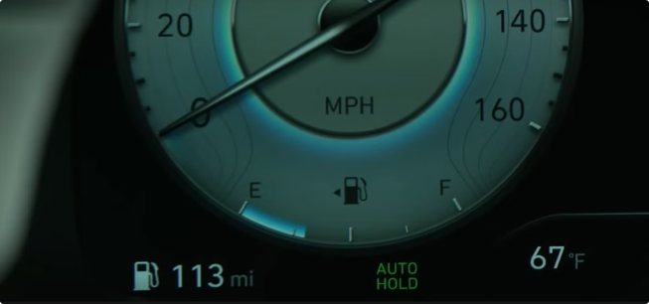


Integrating Auto Hold: A Seamless Experience
Sensor Inputs
The Auto Hold system receives real-time data from various sensors, including wheel speed, brake pressure, and vehicle dynamics.
STM32 Processing
The STM32 microcontroller processes the sensor data and applies the Auto Hold algorithm to maintain brake pressure when the vehicle is stationary.
Vehicle Integration
The Auto Hold system seamlessly integrates with the vehicle's electronic control units, ensuring a transparent and user-friendly experience for the driver.

Slide 10

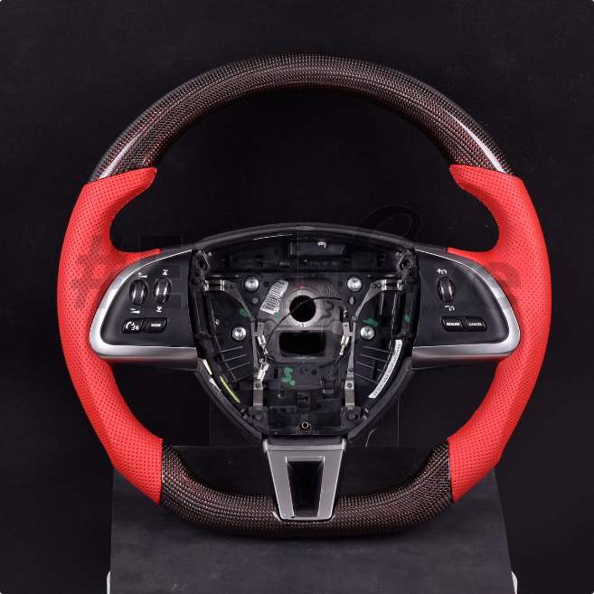
Challenges and Considerations
1
Reliability and Robustness
2
Power Management
Ensuring the Auto Hold feature operates flawlessly in various driving conditions, without compromising safety or performance.
Optimizing the system's power consumption to minimize the impact on the vehicle's battery and electrical system.
3
Seamless Integration
4
Diagnostic Capabilities
Integrating the Auto Hold feature seamlessly with the vehicle's existing systems and user interface for a cohesive driving experience.
Implementing robust diagnostic features to quickly identify and address any issues with the Auto Hold system.

Slide 11


The Future of Auto Hold
Enhanced Functionality
Leveraging advanced sensors and machine learning to provide even more intelligent and adaptive Auto Hold capabilities.
Autonomous Driving Integration
Integrating the Auto Hold feature with autonomous driving technologies for a truly hands-free driving experience.
Energy Efficiency
Optimizing the Auto Hold system's energy consumption to support the growing trend towards electrified and eco-friendly vehicles.

Slide 12
The Pros and Cons of Autohold Technology
Pros
Cons
Autohold automatically maintains brake pressure when the vehicle comes to a stop, preventing the car from rolling forward or backward. This enhances driving convenience and safety, especially in stop-and-go traffic or on hills.
Autohold may drain the vehicle's battery if left engaged for extended periods, as the system continuously holds the brakes. Additionally, the technology could malfunction, potentially leading to unexpected brake behavior and compromising the driver's control.

Slide 13
Thank You

